Slide 1
Car Price Predictor
Dataset: World's largest collection of used cars within the United States, with information about car prices, condition, manufacturer, latitude/longitude, and other 18 other categories.
Output: Prediction of car prices based on these features using methods/models like Linear Regression and Random Forest. For more details, please check our GitHub below.
Source: Kaggle - Craigslist Car Data
GitHub Link: https://github.com/sidrajamshaid/car-price-predictor
Team : Fit4AI ☺

Slide 2
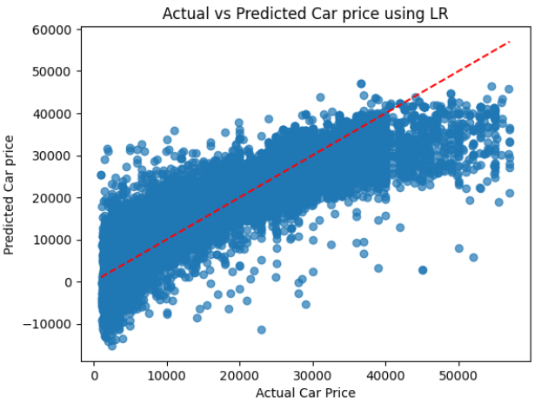
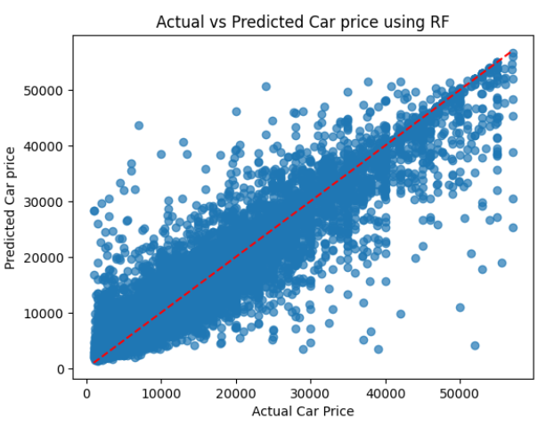
Actual Vs Predicted Car price
Notes:
Linear Regression (First Graph)
Assumes a consistent relationship between year and price.
Predictions tend to miss sharp changes, making it less ideal if real-world data has non-linear effects.
Random Forest (Second Graph)
1. Captures non-linear patterns effectively, handling price fluctuations better.
2. Factors in hidden variables that might influence price trends.
If car prices increase at a steady rate, Linear Regression might be sufficient.
If external factors (inflation, technology, demand shifts) affect prices, Random Forest provides more accurate predictions.
In this case, RF showed better prediction
The Mean Absolute Error (MAE) from both models will indicate which one predicts car prices more accurately.
If LR has lower MAE – price trend is mostly linear. If RF has lower MAE, non linear trends

Slide 3
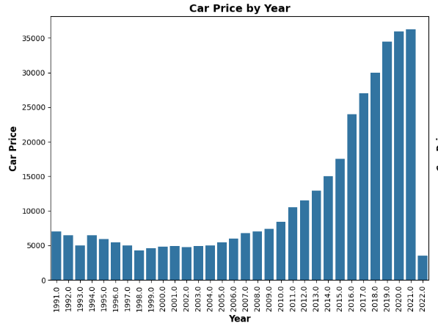
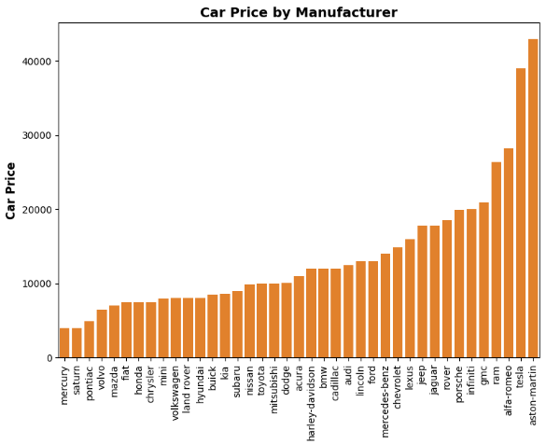
Impact of few features on Car Prices
Notes:
Car Price by Year:
Significant Increase After 2010: Car prices show a sharp upward trend starting from 2010, peaking between 2019 and 2021, reaching above 30,000. This suggests rising costs in recent years, possibly due to inflation, market demand, or technological advancements.
Noticeable Dip Between 1991 and 2000: Prices experienced a decline in the 1990s, followed by a gradual increase leading into 2010. This could indicate market corrections, economic conditions, or shifts in consumer preferences.
Car Price by Manufacturer
Luxury Brands like Aston Martin, Alfa-Romeo, Porsche, and Jaguar have the highest car prices, exceeding 40,000 due to high-end features, exclusivity, and brand reputation.
Budget-Friendly Brands like Mercury, Saturn, Pontiac, and Hyundai have significantly lower prices, staying below 10,000, focusing on affordability and mass-market appeal.

Slide 4
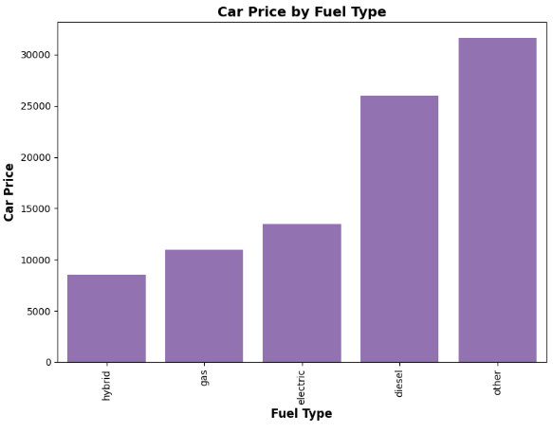
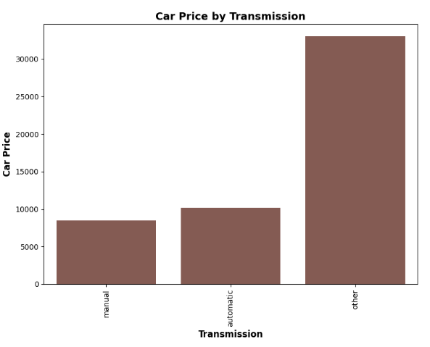
Impact of few features on Car Prices
Notes:
Car Price by Fuel Type:
1. Cars with "Other" fuel types have the highest average price—exceeding 30,000. This category appears to be significantly more expensive than the others.
2. Hybrid cars have the lowest average price—below 10,000, making them the most budget-friendly option among the fuel types compared.
Car Price by Transmission:
Manual transmission cars have the lowest average price, followed by automatic transmission cars, and then “Other” which has the highest average price.

